Slide 1
Module 3: CSEN3103 – Operating System Structures
System Components
Operating System Services
System Calls
System Programs
System Structure
Virtual Machines
System Design and Implementation
System Generation
NILINA BERA, CSE,HIT
Operating System Concepts

Slide 2
Common System Components
Process Management
Main Memory Management
Secondary-Storage Management
I/O System Management
File Management
Protection System
Networking
Command-Interpreter System
Operating System Concepts

Slide 3
Process Management
A process is a program in execution. A process needs certain resources, including CPU time, memory, files, and I/O devices, to accomplish its task.
The operating system is responsible for the following activities in connection with process management.
  Process creation and deletion.
  process suspension and resumption.
  Provision of mechanisms for:
    process synchronization
    process communication
Operating System Concepts

Slide 4
Main-Memory Management
Memory is a large array of words or bytes, each with its own address. It is a repository of quickly accessible data shared by the CPU and I/O devices.
Main memory is a volatile storage device. It loses its contents in the case of system failure.
The operating system is responsible for the following activities in connections with memory management:
  Keep track of which parts of memory are currently being used and by whom.
  Decide which processes to load when memory space becomes available.
  Allocate and deallocate memory space as needed.
Operating System Concepts

Slide 5
Secondary-Storage Management
Since main memory (primary storage) is volatile and too small to accommodate all data and programs permanently, the computer system must provide secondary storage to back up main memory.
Most modern computer systems use disks as the principle on-line storage medium, for both programs and data.
The operating system is responsible for the following activities in connection with disk management:
  Free space management
  Storage allocation
  Disk scheduling
Operating System Concepts

Slide 6
I/O System Management
The I/O system consists of:
  A buffer-caching system
  A general device-driver interface
  Drivers for specific hardware devices
Operating System Concepts

Slide 7
File Management
A file is a collection of related information defined by its creator. Commonly, files represent programs (both source and object forms) and data.
The operating system is responsible for the following activities in connections with file management:
  File creation and deletion.
  Directory creation and deletion.
  Support of primitives for manipulating files and directories.
  Mapping files onto secondary storage.
  File backup on stable (nonvolatile) storage media.
Operating System Concepts

Slide 8
Protection System
Protection refers to a mechanism for controlling access by programs, processes, or users to both system and user resources.
The protection mechanism must:
  distinguish between authorized and unauthorized usage.
  specify the controls to be imposed.
  provide a means of enforcement.
Operating System Concepts

Slide 9
Networking (Distributed Systems)
A distributed system is a collection processors that do not share memory or a clock. Each processor has its own local memory.
The processors in the system are connected through a communication network.
A distributed system provides user access to various system resources.
Access to a shared resource allows:
  Computation speed-up
  Increased data availability
  Enhanced reliability
Operating System Concepts

Slide 10
Command-Interpreter System
Many commands are given to the operating system by control statements which deal with:
  process creation and management
  I/O handling
  secondary-storage management
  main-memory management
  file-system access
  protection
  networking
Operating System Concepts

Slide 11
Command-Interpreter System (Cont.)
The program that reads and interprets control statements is called variously:
  control-card interpreter
  command-line interpreter
  shell (in UNIX)
Its function is to get and execute the next command statement.
Operating System Concepts

Slide 12
Operating System Services
Program execution – system capability to load a program into memory and to run it.
I/O operations – since user programs cannot execute I/O operations directly, the operating system must provide some means to perform I/O.
File-system manipulation – program capability to read, write, create, and delete files.
Communications – exchange of information between processes executing either on the same computer or on different systems tied together by a network. Implemented via shared memory or message passing.
Error detection – ensure correct computing by detecting errors in the CPU and memory hardware, in I/O devices, or in user programs.
Operating System Concepts

Slide 13
Additional Operating System Functions
Additional functions exist not for helping the user, but rather for ensuring efficient system operations.
  Resource allocation – allocating resources to multiple users or multiple jobs running at the same time.
  Accounting – keep track of and record which users use how much and what kinds of computer resources for account billing or for accumulating usage statistics.
  Protection – ensuring that all access to system resources is controlled.
Operating System Concepts

Slide 14
System Calls
System calls provide the interface between a running program and the operating system.
  Generally available as assembly-language instructions.
  Languages defined to replace assembly language for systems programming allow system calls to be made directly (e.g., C. Bliss, PL/360)
Three general methods are used to pass parameters between a running program and the operating system.
  Pass parameters in registers.
  Store the parameters in a table in memory, and the table address is passed as a parameter in a register.
  Push (store) the parameters onto the stack by the program, and pop off the stack by operating system.
Operating System Concepts

Slide 15
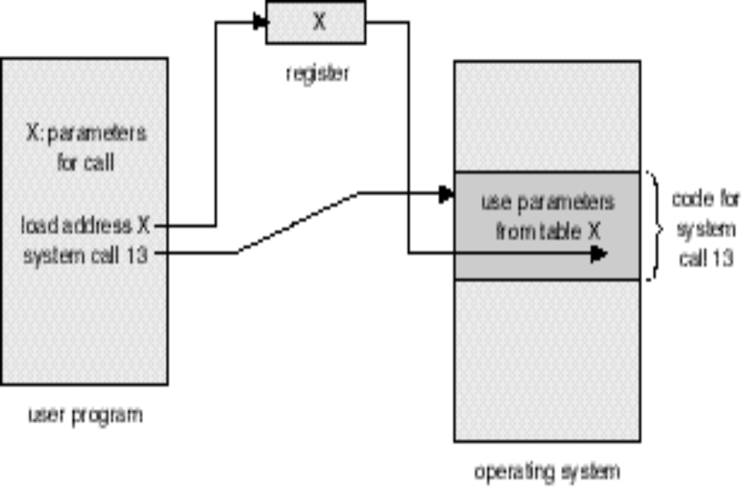
Passing of Parameters As A Table
Operating System Concepts

Slide 16
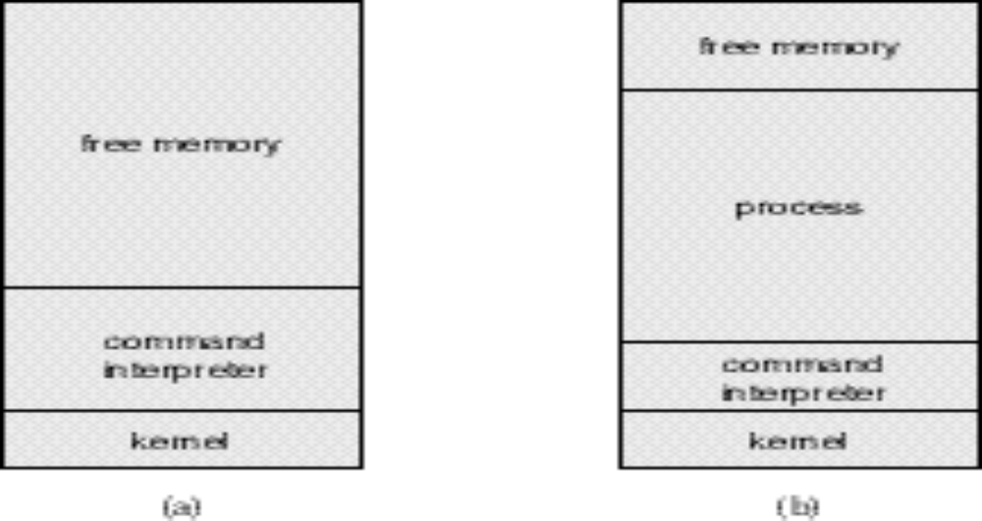
MS-DOS Execution
At System Start-up
Running a Program
Operating System Concepts

Slide 17
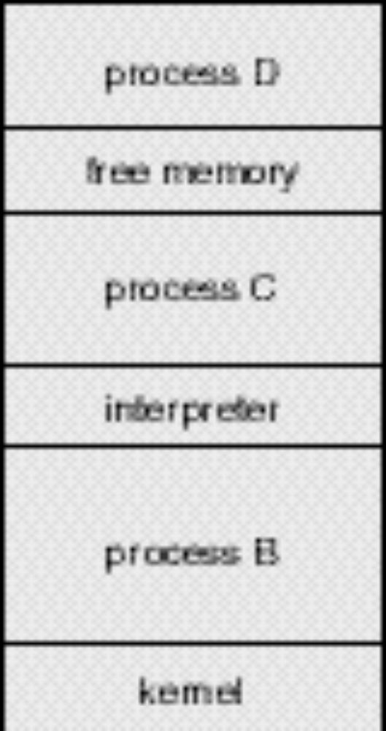
UNIX Running Multiple Programs
Operating System Concepts

Slide 18
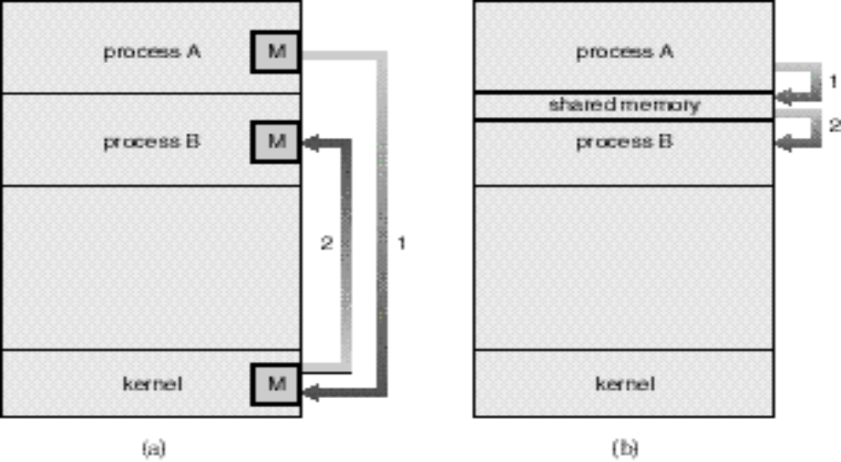
Communication Models
Msg Passing
Shared Memory
Operating System Concepts

Slide 19
System Programs
System programs provide a convenient environment for program development and execution. The can be divided into:
  File manipulation
  Status information
  File modification
  Programming language support
  Program loading and execution
  Communications
  Application programs
Most users’ view of the operation system is defined by system programs, not the actual system calls.
Operating System Concepts

Slide 20
System Structure – Simple Approach
MS-DOS – written to provide the most functionality in the least space
  not divided into modules
  Although MS-DOS has some structure, its interfaces and levels of functionality are not well separated
Operating System Concepts

Slide 21
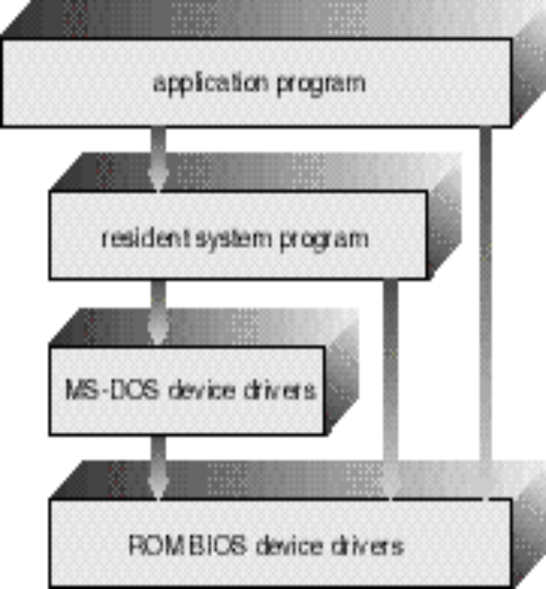
MS-DOS Layer Structure
Operating System Concepts

Slide 22
System Structure – Simple Approach (Cont.)
UNIX – limited by hardware functionality, the original UNIX operating system had limited structuring. The UNIX OS consists of two separable parts.
  Systems programs
  The kernel
    Consists of everything below the system-call interface and above the physical hardware
    Provides the file system, CPU scheduling, memory management, and other operating-system functions; a large number of functions for one level.
Operating System Concepts

Slide 23
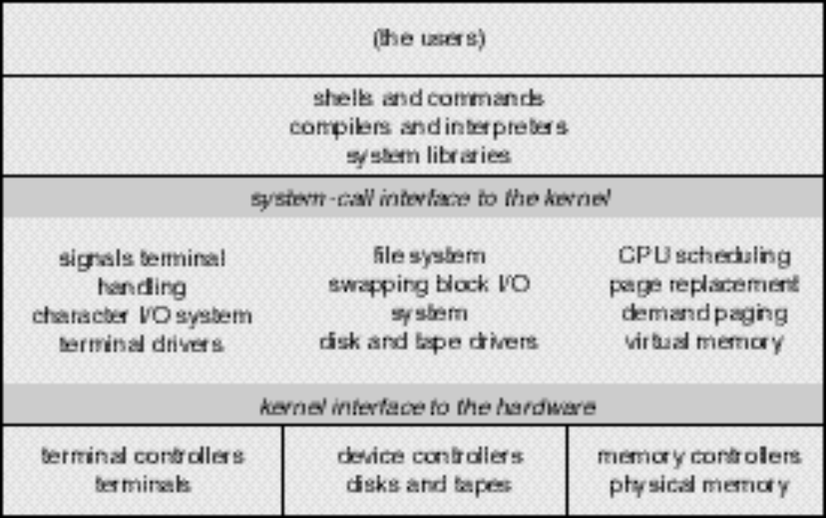
UNIX System Structure
Operating System Concepts

Slide 24
System Structure – Layered Approach
The operating system is divided into a number of layers (levels), each built on top of lower layers. The bottom layer (layer 0), is the hardware; the highest (layer N) is the user interface.
With modularity, layers are selected such that each uses functions (operations) and services of only lower-level layers.
Operating System Concepts

Slide 25
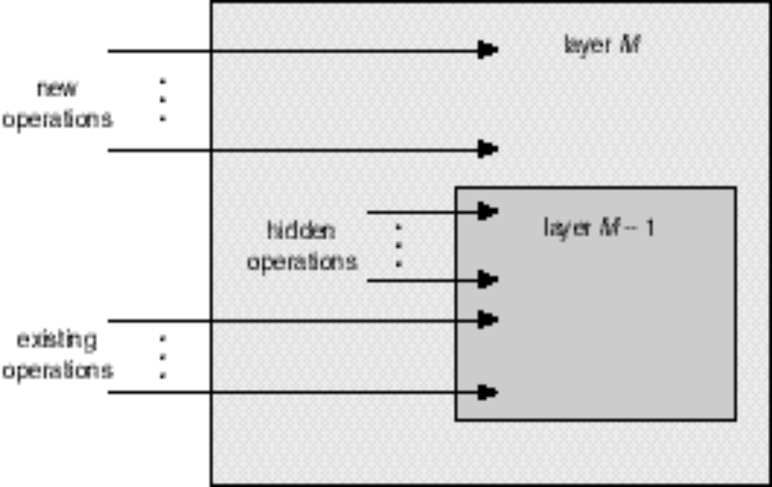
An Operating System Layer
Operating System Concepts

Slide 26
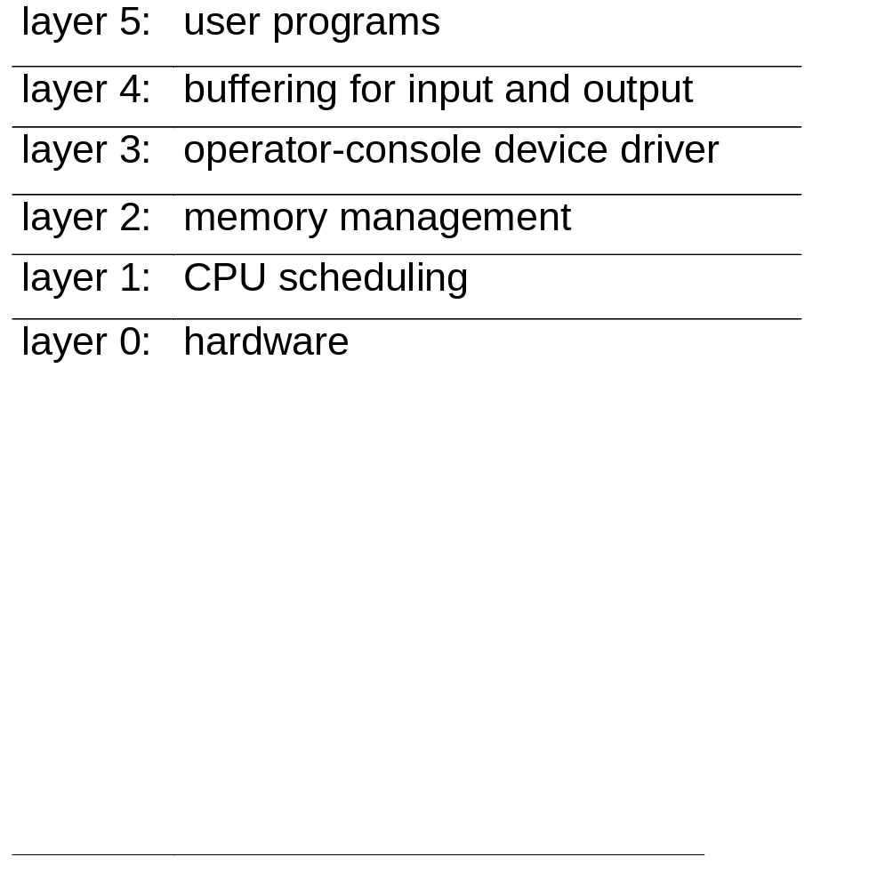
Layered Structure of the THE OS
A layered design was first used in THE operating system.
Its six layers are as follows:
Operating System Concepts

Slide 27
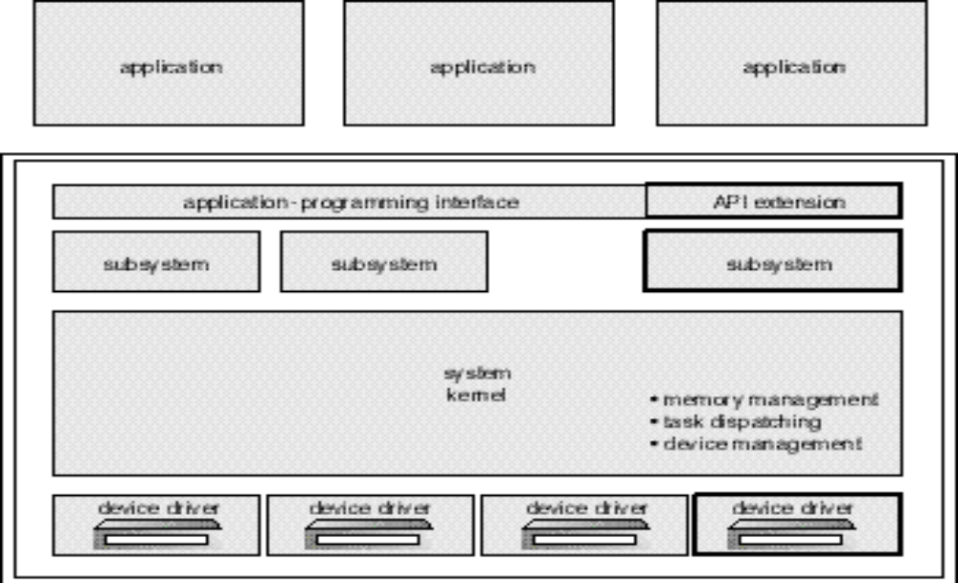
OS/2 Layer Structure
Operating System Concepts

Slide 28
Virtual Machines
A virtual machine takes the layered approach to its logical conclusion. It treats hardware and the operating system kernel as though they were all hardware.
A virtual machine provides an interface identical to the underlying bare hardware.
The operating system creates the illusion of multiple processes, each executing on its own processor with its own (virtual) memory.
Operating System Concepts

Slide 29
Virtual Machines (Cont.)
The resources of the physical computer are shared to create the virtual machines.
  CPU scheduling can create the appearance that users have their own processor.
  Spooling and a file system can provide virtual card readers and virtual line printers.
  A normal user time-sharing terminal serves as the virtual machine operator’s console.
Operating System Concepts

Slide 30
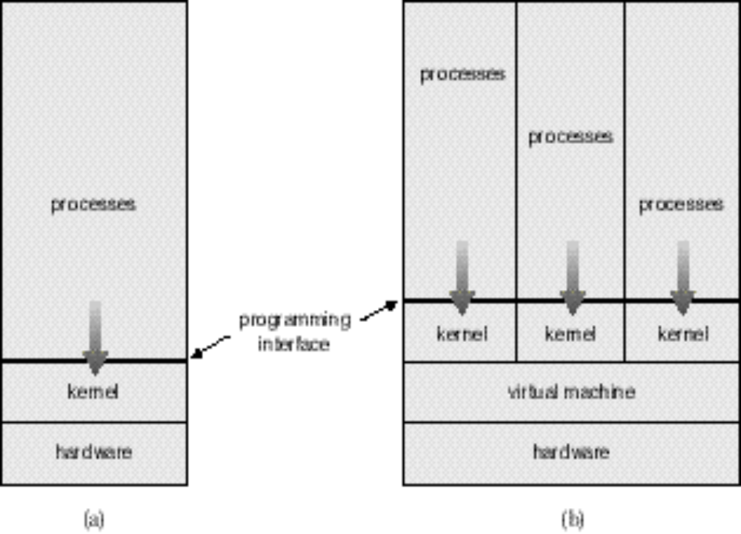
System Models
Non-virtual Machine
Virtual Machine
Operating System Concepts

Slide 31
Advantages/Disadvantages of Virtual Machines
The virtual-machine concept provides complete protection of system resources since each virtual machine is isolated from all other virtual machines. This isolation, however, permits no direct sharing of resources.
A virtual-machine system is a perfect vehicle for operating-systems research and development. System development is done on the virtual machine, instead of on a physical machine and so does not disrupt normal system operation.
The virtual machine concept is difficult to implement due to the effort required to provide an exact duplicate to the underlying machine.
Operating System Concepts

Slide 32
System Design Goals
User goals – operating system should be convenient to use, easy to learn, reliable, safe, and fast.
System goals – operating system should be easy to design, implement, and maintain, as well as flexible, reliable, error-free, and efficient.
Operating System Concepts

Slide 33
Mechanisms and Policies
Mechanisms determine how to do something, policies decide what will be done.
The separation of policy from mechanism is a very important principle, it allows maximum flexibility if policy decisions are to be changed later.
Operating System Concepts

Slide 34
System Implementation
Traditionally written in assembly language, operating systems can now be written in higher-level languages.
Code written in a high-level language:
  can be written faster.
  is more compact.
  is easier to understand and debug.
An operating system is far easier to port (move to some other hardware) if it is written in a high-level language.
Operating System Concepts

Slide 35
System Generation (SYSGEN)
Operating systems are designed to run on any of a class of machines; the system must be configured for each specific computer site.
SYSGEN program obtains information concering the specific configuration of the hardware system.
Booting – starting a computer by loading the kernel.
Bootstrap program – code stored in ROM that is able to locate the kernel, load it into memory, and start its execution.
Operating System Concepts

